Slide 1
Journal Watch Presentation
Fereshteh Davoodi
Ph.D. Candidate in Epidemiology
Kermanshah University of Medical Sciences
Under Dr Shahab Rezaeian S.V.

Slide 2
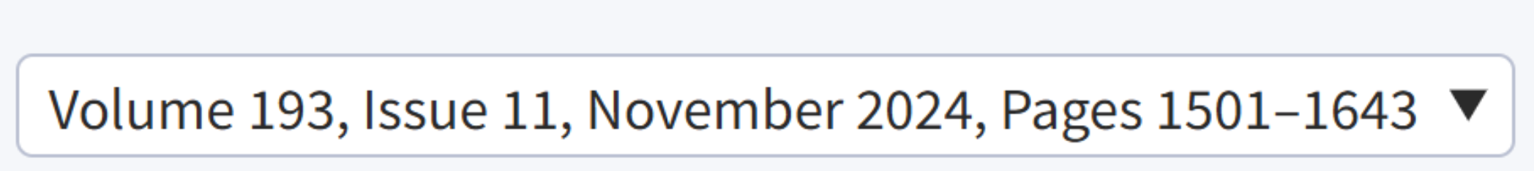

https://academic.oup.com/aje

Slide 3
Overview of the American Journal of Epidemiology (AJE)
Introduction to AJE:
Established in 1920, the American Journal of Epidemiology is one of the leading journals in the field of epidemiology.
Published by Oxford University Press on behalf of the Johns Hopkins Bloomberg School of Public Health.
Scope:
Covers a wide range of epidemiological topics, including:
Chronic and infectious diseases
Environmental and occupational health
Social and behavioral epidemiology
Statistical and methodological advancements
Highlights studies addressing global and regional public health issues.
Notable Features:
Focuses on both etiological research (causes of diseases) and applied public health research.
Strong emphasis on the practical application of epidemiological findings to improve global health.
Original Research Articles, Methodological Articles, Systematic Reviews and Meta-Analyses, Special Issues and Supplements, Commentaries

Slide 4
Overview of the American Journal of Epidemiology (AJE)
Impact and Readership:
Recognized as one of the most influential journals in epidemiology.
Attracts a diverse audience, including researchers, clinicians, and policymakers.
Current impact factor (as of 2023): 5
Availability:
Published monthly, with articles available online for broader accessibility.
Offers both open-access and subscription-based content.

Slide 5
DNA Methylation as a Possible Mechanism Linking Childhood Adversity and Health
Definition and Significance
Childhood Adversity: Refers to experiences during childhood that can cause significant stress or trauma, including:
Abuse (physical, emotional, sexual)
Neglect (emotional, physical)
Household dysfunction (e.g., parental substance abuse, mental illness, domestic violence)
Significance:
Acknowledged as a critical public health issue.
Associated with various negative outcomes across the life course, affecting emotional, behavioral, and physical health.
Impact on Long-Term Health
Psychological Outcomes:
Increased risk of mental health disorders (e.g., depression, anxiety, PTSD).
Higher rates of behavioral issues, including ADHD and conduct disorders.
Physical Health Outcomes:
Greater susceptibility to chronic diseases (e.g., heart disease, diabetes).
Links to unhealthy lifestyle choices (e.g., substance abuse, poor diet).
Overall Life Trajectory:
Adversity can lead to diminished quality of life, lower educational attainment, and reduced economic opportunities.

Slide 6
DNA Methylation as a Possible Mechanism Linking Childhood Adversity and Health
Epigenetic Modifications
Definition of Methylation (DNAm):
DNA methylation is an epigenetic modification where a methy group is added to the DNA molecule, typically at cytosine bases in the context of CpG dinucleotides.
This process can alter gene expression without changing the underlying DNA sequence.
Role in Gene Expression and Health:
Gene Regulation:
DNAm can silence or activate genes, influencing cellular function and development.
It plays a crucial role in processes such as cellular differentiation and response to environmental stimuli.
Health Implications:
Aberrant DNAm patterns are associated with various diseases, including cancer, autoimmune disorders, and mental health conditions.
DNAm changes can serve as biomarkers for exposure to environmental stressors, including childhood adversity, and may help in understanding individual susceptibility to diseases.

Slide 7
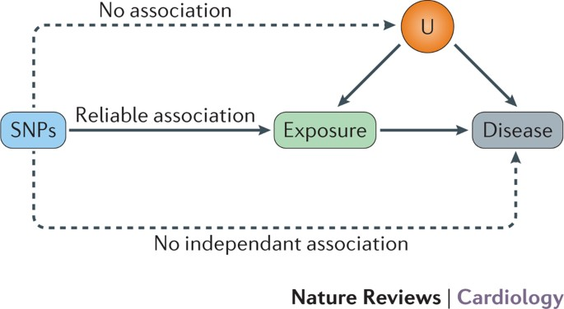
DNA Methylation as a Possible Mechanism Linking Childhood Adversity and Health
Study Goals
Investigate causal relationships between adversity-related DNAm and health outcomes
Examine developmental timing of DNAm alterations
Methodology
2-Sample Mendelian Randomization
Mendelian Randomization (MR)
Definition: A statistical method using genetic variants as tools to study causal links between exposures (e.g., behaviors, environmental factors) and outcomes (e.g., diseases).
Key Premise: Genetic variants associated with modifiable exposures can reveal if those exposures causally impact health outcomes.

Slide 8
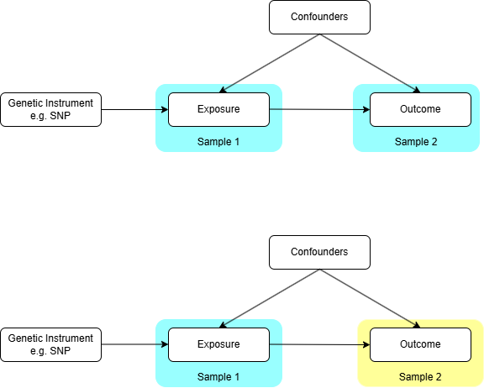
DNA Methylation as a Possible Mechanism Linking Childhood Adversity and Health
Key Principles of 2-Sample Mendelian Randomization
Instrumental Variables:
Genetic variants (usually single nucleotide polymorphisms, or SNPs) are used as instruments. These variants should:
Be strongly associated with the exposure of interest (in this case, DNA methylation).
Not be associated with confounders that affect both the exposure and outcome.
Affect the outcome only through the exposure (no direct effect).
Two-Sample Design:
In 2-sample MR, two independent datasets are used:
Sample 1: This dataset is used to establish the association between genetic variants and the exposure (DNAm).
Sample 2: This dataset is used to evaluate the relationship between the same genetic variants and the health outcomes (e.g., mental and physical health conditions).
This approach allows researchers to leverage large biobanks or genome-wide association studies

Slide 9
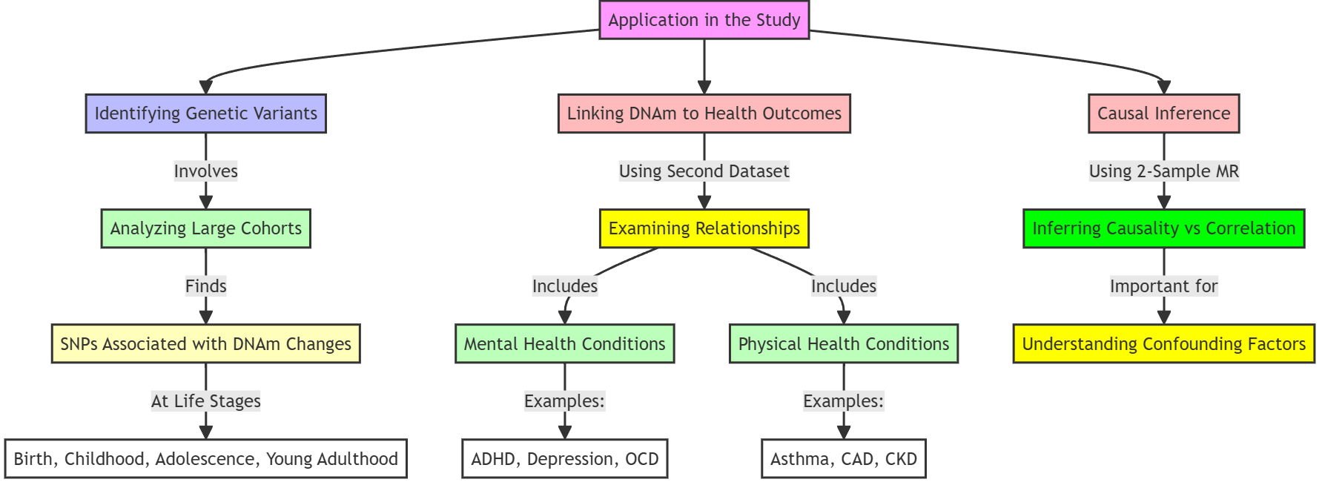
DNA Methylation as a Possible Mechanism Linking Childhood Adversity and Health

Slide 10
DNA Methylation as a Possible Mechanism Linking Childhood Adversity and Health
Developmental Timing:
The study also explored how the timing of DNAm alterations (e.g., during birth, childhood, adolescence) affects health outcomes. This is crucial for understanding when interventions might be most effective and how different life stages may influence susceptibility to health issues.
Results Interpretation
The study found strong associations between adversity-associated DNAm and various health outcomes, particularly highlighting that:
Early Developmental Stages: DNAm changes during birth and childhood were significantly linked to both mental and physical health outcomes.
Adolescent and Young Adulthood: DNAm alterations during these stages were more closely associated with mental health issues.
Risk-Suppressing Relationships: The findings suggested that some DNAm loci might act as compensatory mechanisms, potentially buffering against the adverse effects of childhood adversity.

Slide 11
Childhood adversity and time to pregnancy in a preconception cohort
Introduction
Examine the association between childhood adversity and fecundability.
Assess the modifying effect of childhood social support.
Study Population
6318 female participants aged 21-45 years.
Data from Pregnancy Study Online (PRESTO), 2013-2022.
Methodology
Social Support Measurement:
Modified Berkman-Syme Social Network Index (SNI)
Data Collection:
Baseline questionnaire.
Bimonthly follow-up questionnaires.
Supplemental questionnaire on life experiences (ACEs and social support).
Outcome Measures:
Computation of fecundability ratios (FRs) and 95% confidence intervals (CIs).

Slide 12
Childhood adversity and time to pregnancy in a preconception cohort
Statistical Analysis
Proportional probabilities regression models (like logistic regression is valuable for analyzing categorical outcomes, Logistic regression is ideal for binary outcomes, whereas proportional probabilities regression is suited for ordinal outcomes).
Key Findings
Adjusted Fecundability Ratios:
ACE scores 1-3 vs 0: FR = 0.91 (95% CI, 0.85-0.97) (Meaning: Women with 1-3 ACEs have a 9% lower probability of conception per cycle compared to women with 0 ACEs.)
ACE scores ≥4 vs 0: FR = 0.84 (95% CI, 0.77-0.91) (Meaning: Women with 4 or more ACEs have a 16% lower probability of conception per cycle compared to women with 0 ACEs.)
Conclusion
Both findings indicate a negative association between childhood adversity (as measured by ACE scores) and fecundability. Higher ACE scores are linked to lower probabilities of conception, with a more pronounced effect observed in those with 4 or more ACEs.

Slide 13
Childhood adversity and time to pregnancy in a preconception cohort
Key Findings
Social Support Impact
Fecundability Ratios by Social Support:
High social support (SNI ≥4) for ACE scores ≥4 vs 0: FR = 0.86 (95% CI, 0.78-0.94) (Meaning: Women with 4 or more ACEs who reported high social support have a 14% lower probability of conception per cycle compared to women with 0 ACEs.)
Low social support (SNI <4) for ACE scores ≥4 vs 0: FR = 0.78 (95% CI, 0.56-1.07) (Meaning: Women with 4 or more ACEs who reported low social support have a 22% lower probability of conception per cycle compared to women with 0 ACEs.)
Conclusion
Impact of Social Support on Fecundability:
High Social Support: Provides a buffer against the negative effects of childhood adversity on fecundability, although women with high ACE scores still face reduced conception probabilities.
Low Social Support: Indicates a trend toward lower fecundability, but lacks statistical significance, leading to uncertainty about the strength of this association.

Slide 14
A simulation-based bias analysis to assess the impact of unmeasured confounding when designing nonrandomized database studies
Background:
Definition:
Unmeasured confounding
Impact on nonrandomized studies.
Challenge:
Difficulty in quantifying the impact of unmeasured confounding.
Objective of the Study:
Develop a simulation-based method to assess the impact of unmeasured confounding during study design.

Slide 15
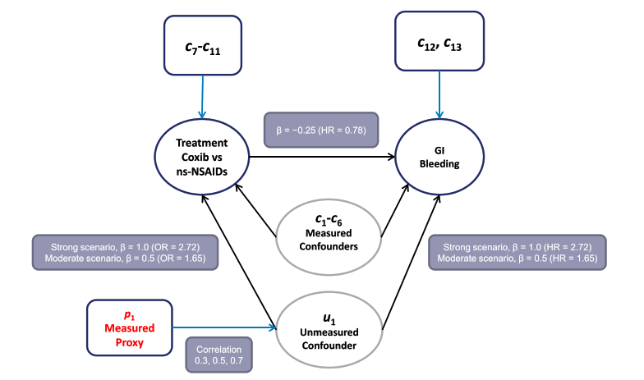
Assessing Unmeasured Confounding in Nonrandomized Studies; A Simulation-Based Approach
Methodology Overview
Simulation-Based Approach:
Generation of hypothetical individual-level cohorts.
Parameters used in simulations:
Binary treatment (25% prevalence).
Time-to-event outcome (5% incidence).
13 measured covariates.
Binary unmeasured confounder (10% prevalence).
Binary measured proxy variable.

Slide 16
Simulation Scenarios
Varying Parameters:
Strengths of unmeasured confounding.
Correlations between unmeasured confounder and proxy variable.
Adjustment Levels Analyzed:
No adjustment.
Adjustment for measured confounders (Level 1).
Adjustment for measured confounders and proxy (Level 2).
Results - Adjustment Effects
Findings:
absolute standardized mean differences in u1 and p1 and relative bias with each level of adjustment.
Level 2 adjustment improved balance of unmeasured confounder.
Lower relative bias compared to Level 1 adjustments.
Specific Bias Percentages:
Strong unmeasured confounding scenarios:
Correlation 0.7: Relative bias of 9.2% (Level 2) vs 16.4% (Level 1).
Correlation 0.5: Relative bias of 12.2% (Level 2) vs 15.8% (Level 1).
Correlation 0.3: Relative bias of 13.5% (Level 2) vs 15.0% (Level 1).
Conclusions
Simulation approach effectively conveys potential bias due to unmeasured confounding.
Useful for informing design choices in nonrandomized studies.
Assessing Unmeasured Confounding in Nonrandomized Studies; A Simulation-Based Approach

Slide 17
Antidepressant drugs and risk of developing glioma: a national registry-based case-control study and a meta-analysis
Introduction
Overview of glioma and its significance
Purpose of the study: Investigating antidepressants and glioma risk
Study Design
Description of the national registry-based case-control study
Population: 1,283 glioma cases vs. 6,400 controls
Timeframe: 2009-2013 in Sweden
Methodology
Use of conditional logistic regression for analysis
Types of antidepressants analyzed: SSRIs and non-SSRIs

Slide 18
Antidepressant drugs and risk of developing glioma: a national registry-based case-control study and a meta-analysis
Key Findings
No significant association between antidepressant use and glioma risk
Results of the meta-analysis combining three studies
Modest risk reduction observed (odds ratio = 0.90; 95% CI, 0.83-0.97)
Discussion
Interpretation of results
Potential implications of findings on treatment and prevention
Consideration of common monoaminergic mechanisms

Slide 19
Assessing trends in internalizing symptoms among radicalized and minoritized adolescents: results from the Monitoring the Future Study 2005-2020
Introduction
Overview of the issue of adolescent mental health
Importance of understanding depressive symptoms among racialized and minoritized groups
Study Objectives
To assess trends in depressive symptoms using Monitoring the Future survey data (2005-2020)
Focus on racialized and minoritized adolescents using within-group analyses
Methodology
Analysis of symptom severity was performed across racial/minority groups and across ages.
Logistic regression models were used to estimate the odds ratio of symptom severity in newer generations compared to older generations.
Controls: Demographic factors (such as age and gender) were included to control for confounding factors.

Slide 20
Assessing trends in internalizing symptoms among racialized and minoritized adolescents: results from the Monitoring the Future Study 2005-2020
Key Findings
Increase in high depressive symptoms in recent birth cohorts
For example, among 15- to 16-year-old students racialized as American Indian or Alaska Native and Black Hispanic/Latine, the 2003-2006 birth cohort had 3.08 (95% CI, 2.00-4.76) and 6.95 (95% CI, 2.70-17.88) times’ higher odds, respectively, of high depressive symptoms as compared with the 1987-1990 birth cohorts.
Moreover,in a given year, 15- to 16-year-olds generally experienced the highest depressive symptoms compared with 13- to 14-year-olds and 17- to 18-year-olds
Age effects: peak depressive symptoms at ages 15-16
Discussion
Implications of findings for public health
The role of structural racism in mental health disparities
Need for culturally competent mental health services

Slide 21
Building transparency and reproducibility into the practice of pharmacoepidemiology and outcomes research
Introduction
Definition of real-world evidence (RWE) studies
Importance of RWE in policy and clinical decision-making
Overview of concerns regarding credibility and reproducibility
The Need for Transparency
Discussion on the significance of transparent and reproducible science
Current gaps in transparency practices within pharmacoepidemiology

Slide 22
Building transparency and reproducibility into the practice of pharmacoepidemiology and outcomes research
Proposed Framework for Transparency
Introduction of the transparency statement concept
Overview of the five key domains:
Protocol
Preregistration
Data
Code-sharing
Reporting checklists
Implementation of Transparency Statements
How researchers can integrate transparency statements into their work
Benefits of displaying open science practices
Implications for Research and Policy
Impact of transparency on public health policy and practice
Building trust in research findings
Conclusion
Recap of the importance of transparency in RWE studies
Future directions for enhancing transparency in research

Slide 23
Endometrial Cancer Survival in Populations of African Descent
Objective: To investigate whether the survival disadvantage in endometrial cancer (EC) among Black populations is unique to the US by comparing cases from different countries with high development index.
Study Overview:
Data Analyzed: 28,213 EC cases from cancer registries in Florida (2005-2018) and the French Caribbean islands of Martinique (2005-2018) and Guadeloupe (2008-2018) combined.
Methods Used: Kaplan-Meier and Cox proportional hazards models to compare survival rates, stratified by EC histology type.
The main predictor examined was race/ethnicity (non-Hispanic White [NHW] and no-Hispanic Black [NHB] women in the United States versus Black women residing in the Caribbean).
For endometrioid and nonendometrioid EC, after adjusting for age, histology, stage at diagnosis, receipt of surgery, period of diagnosis, and poverty level

Slide 24
Endometrial Cancer Survival in Populations of African Descent
Key Findings:
Survival Disparities:
Both US non-Hispanic Black (NHB) women and Caribbean Black women exhibited higher mortality risks compared to US non-Hispanic White (NHW) women after adjusting for various factors.
No significant survival difference was found between US NHB and Caribbean Black women with endometrioid EC (HR = 1.07).
Caribbean Black women with non endometrioid carcinomas faced a 40% higher risk of death compared to US NHB women (HR = 1.40).
Conclusion: The low survival rates among US Black women are mirrored in Caribbean populations of African descent, particularly for aggressive non endometrioid EC types, highlighting a broader issue of health disparities.
Note: This study is part of a Special Collection on Gynecological Cancers.

Slide 25
Residential proximity to agricultural pesticide use and cardiovascular disease risk factors among adult Latina women in California’s Salinas Valley
Background:
Cardiovascular disease is a leading global health concern. This study investigates the potential link between residential proximity to agricultural pesticide use and cardiovascular risk factors among adult Latina women in California’s Salinas Valley.
Study Overview:
Participants: 484 adult women from the CHAMACOS Study, conducted in an agricultural region.
Data Collection: Outcome assessment occurred between 2010 and 2013, utilizing residential addresses and California’s Pesticide Use Reporting database to estimate pesticide exposure within 1 km of homes over the previous two years.
Analysis Approach:
Utilized Bayesian hierarchical modeling to assess the relationships between exposure to 14 agricultural pesticides and various health metrics, including:
Waist Circumference
Body Mass Index (BMI)
Blood Pressure

Slide 26
Bayesian Hierarchical Modeling
Definition: Bayesian hierarchical modeling is a statistical method that allows for the analysis of data with multiple levels of variability. It combines Bayesian statistics with a hierarchical structure to model complex relationships in data.
Key Features:
Hierarchical Structure:
Data is organized in levels (e.g., individual measurements nested within groups).
This structure accounts for variations at different levels (e.g., individual vs. group-level effects).
Bayesian Framework:
Incorporates prior beliefs or information (prior distributions) about parameters before observing the data.
Updates these beliefs based on the observed data to produce posterior distributions.
Flexibility:
Can model complex relationships and account for different sources of variability (e.g., individual differences, group effects).
Suitable for small sample sizes or when data is sparse.
Parameter Estimation:
Estimates parameters using the entire dataset, improving the robustness of the estimates.
Provides credible intervals for parameter estimates, offering a probabilistic interpretation.

Slide 27
Example Application:
In the context of this study on agricultural pesticides:
Level 1: Individual women’s health metrics (e.g., waist circumference, BMI, blood pressure).
Level 2: Group-level effects (e.g., pesticide exposure levels in different regions).
The model can assess how individual health metrics are influenced by both personal characteristics and broader environmental factors, while appropriately accounting for the hierarchical structure of the data.
Benefits:
Provides a comprehensive framework for understanding complex data.
Allows for the incorporation of uncertainty in parameter estimates.
Enhances the interpretability of results in the context of multiple influencing factors.

Slide 28
Residential proximity to agricultural pesticide use and cardiovascular disease risk factors among adult Latina women in
Key Findings:
Pesticides Examined: Focused on 14 agricultural pesticides.
Associations Identified:
Paraquat: Each 10-fold increase in application linked to a rise in diastolic blood pressure (β = 2.60 mm Hg; 95% CrI, 0.27-4.89).
Glyphosate: Each 10-fold increase associated with increased pulse pressure (β = 2.26 mm Hg; 95% CrI, 0.09-4.41).
Other Pesticides: No significant associations observed.
Conclusion: The study suggests that chronic environmental exposure to paraquat and glyphosate may contribute to cardiovascular disease risk among women.
Note: This research is part of a Special Collection on Environmental Epidemiology.

Slide 29
Suicide deaths involving opioid poisoning in the United States, by sex, 1999-2021
Overview:
Suicide is a leading cause of death in the U.S.
Recent data indicates an increase in opioid-related suicide deaths.
Study Purpose:
To analyze trends in suicide deaths involving opioid poisoning from 1999 to 2021, focusing on biological sex differences.
Data from the US Centers for Disease Control and Prevention’s WONDER database
Key Findings:
Overall Trends:
Both male and female suicide deaths involving opioids increased until 2010.
Post-2010, trends diverged:
Female rates outpaced male rates.
Male rates stabilized while female rates declined, narrowing the sex gap.
Proportions:
Female decedents consistently showed higher proportions of opioid-related suicide deaths (5.8%-11.0%) compared to males (1.4%-2.8%).

Slide 30
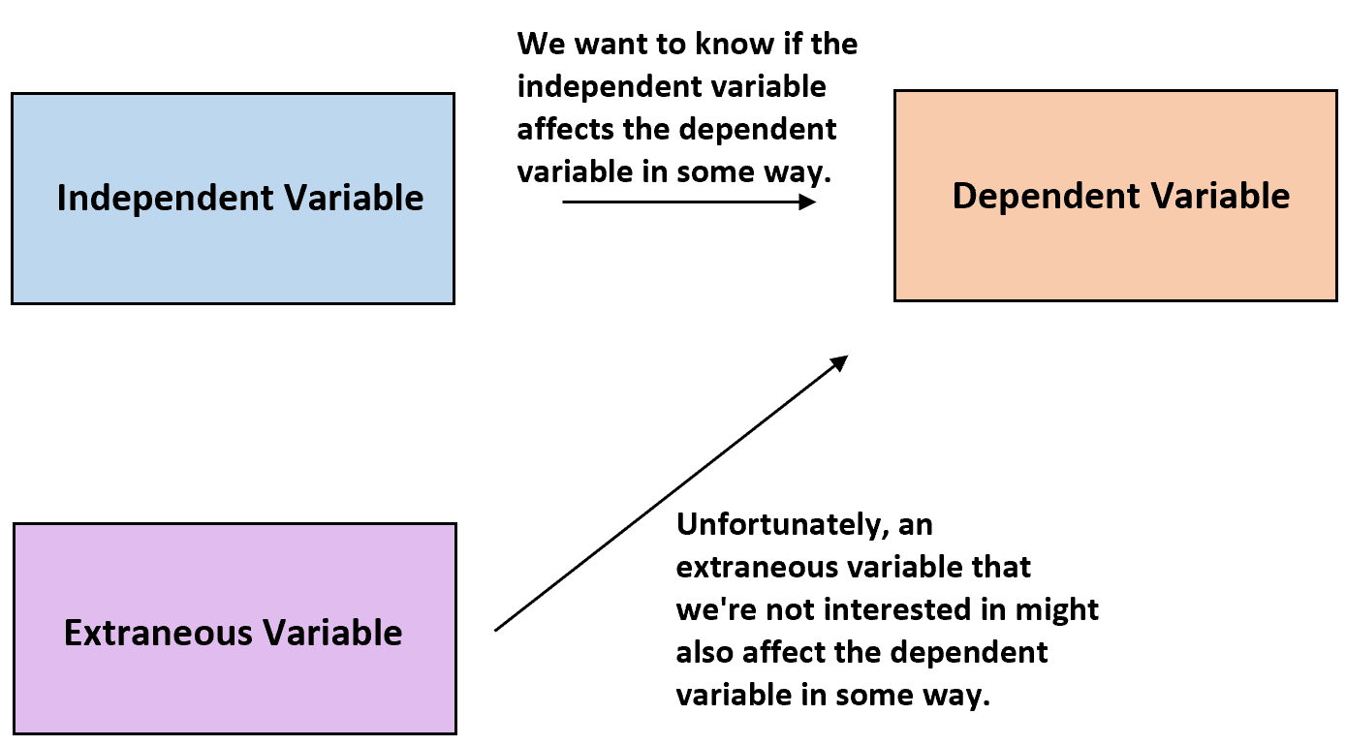
Targeted learning with an undersmoothed LASSO propensity score model for large-scale covariate adjustment in health-care database studies
Focus: Estimating causal relationships while addressing confounding factors.
Key Issue: Confounding occurs when extraneous variables affect both treatment assignment and outcomes.

Slide 31
Targeted learning with an undersmoothed LASSO propensity score model for large-scale covariate adjustment in health-care database studies
Context and Problem
In healthcare studies, researchers often need to estimate causal effects (e.g., the effect of a treatment on patient outcomes). To do this, they use propensity scores (PS), which estimate the probability of receiving a treatment based on covariates (e.g., demographics, comorbidities). Large-scale healthcare databases present challenges like:
A large number of covariates.
High-dimensional data, where traditional regression models might struggle to select relevant variables.
Nonoverlap in covariates between treatment groups, leading to biased causal effect estimates.
To address this, researchers turn to the Least Absolute Shrinkage and Selection Operator (LASSO) regression, which is well-suited for high-dimensional data.
However, LASSO may undersmooth (or overfit) PS models, which can control confounding better but exacerbate issues like nonoverlap.

Slide 32
Targeted learning with an undersmoothed LASSO propensity score model for large-scale covariate adjustment in health-care database studies
What They Did
The authors explored a way to dynamically optimize the degree of undersmoothing (overfitting) in LASSO-based PS models using collaborative-controlled targeted learning (CCTL). Their goal was to:
Reduce bias in causal effect estimates.
Balance the trade-off between controlling confounding and avoiding nonoverlap in covariates.
Test the effectiveness of their approach using simulations.

Slide 33
Targeted learning with an undersmoothed LASSO propensity score model for large-scale covariate adjustment in health-care database studies
Methodological Approaches
Propensity Score (PS):
Definition: The propensity score is the probability of being assigned to a treatment group, given observed covariates. It helps adjust for confounding by balancing covariates between treated and untreated groups.
Purpose in Causal Inference: By matching, weighting, or stratifying on PS, researchers mimic a randomized experiment, reducing bias in causal estimates.
LASSO Regression:
What It Does: LASSO is a regularization method that:
Selects important variables by shrinking the coefficients of less relevant variables to zero.
Handles high-dimensional data efficiently.
Why Use It for PS Estimation?: Healthcare databases have many variables, and LASSO helps select the most relevant ones for PS estimation.

Slide 34
Targeted learning with an undersmoothed LASSO propensity score model for large-scale covariate adjustment in health-care database studies
Undersmoothed LASSO PS Models:
What is Undersmoothing?
A deliberately looser model fit (overfitting) that retains more covariates than typically necessary.
Ensures that relevant confounders, even those weakly associated with treatment, are included.
Pros and Cons:
Pro: Improves confounding control by including more variables.
Con: May lead to nonoverlap—regions of covariate space where treated and untreated groups do not share similar covariate distributions, making causal estimates less reliable.
Collaborative-Controlled Targeted Learning (CCTL):
Purpose: Dynamically choose the degree of undersmoothing to strike a balance between confounding control and overlap.
How It Works:
Uses targeted learning, which iteratively updates the model to directly minimize bias in the causal estimate.
Incorporates cross-fitting, which involves splitting the dataset into parts to avoid overfitting and improve generalizability.

Slide 35
Targeted learning with an undersmoothed LASSO propensity score model for large-scale covariate adjustment in health-care database studies
Key Findings
Dynamic Selection of Undersmoothing: By adapting the degree of undersmoothing in LASSO PS models using collaborative learning, researchers could reduce bias in causal estimates more effectively than standard approaches.
Cross-Fitting: This step was critical to avoid overfitting and to ensure the PS model performed well across different subsets of data.
Nonoverlap Avoidance: While undersmoothing risks nonoverlap, the proposed method managed this trade-off effectively, ensuring better covariate balance.

Slide 36
The end of court-ordered desegregation and US children’s health: quasi-experimental evidence
• Background:
School segregation and racial disparities: When schools are segregated (students are separated based on race), it can lead to racial inequalities in resources, opportunities, and outcomes, including children's health.
Court-ordered desegregation: In the past, court rulings required schools to integrate to combat racial segregation. However, since 1991, Supreme Court decisions have made it easier for school districts to stop following these desegregation orders.
• Objective of the study:
The researchers wanted to see how ending court-ordered desegregation has affected the health of Black and White children in the United States.

Slide 37
The end of court-ordered desegregation and US children’s health: quasi-experimental evidence
Data:
They used data from the National Health Interview Survey (1997–2018), which includes information about the health of children.
The sample consisted of:
8,182 Black children.
16,930 White children.
Methods:
They analyzed what happened when school districts were released from desegregation orders at different times. Because these releases occurred at varying times and were not directly controlled by the researchers, this created a quasi-experimental setting.
To assess health impacts, the researchers focused on:
General health: How children rated their overall health.
Body weight.
Mental health.
Asthma: Risk of asthma episodes.

Slide 38
Quasi-Random Variation
The key to the study’s causal inference is exploiting the quasi-random variation in the timing of these releases:
Quasi-Randomness: Refers to variations that are not strictly random but are treated as such for analytical purposes. For example, the timing of court releases is likely independent of the individual characteristics of students, making it a good natural experiment for causal inference.

Slide 39
The end of court-ordered desegregation and US children’s health: quasi-experimental evidence
Statistical Analysis
Difference-in-differences (DiD) method:
This method compares changes in outcomes (e.g., child health) for groups affected by the policy (districts released from desegregation orders) with those not yet affected. This helps isolate the impact of the policy.
The study used heterogeneity-robust estimators, which are techniques to account for variation in the data and provide more reliable results.
Event-study method:
This tracks changes over time before and after the release of desegregation orders to see how outcomes evolved. It helps understand short-term and long-term effects.

Slide 40
The end of court-ordered desegregation and US children’s health: quasi-experimental evidence
Key findings:
Increased school segregation:
After districts were released from desegregation orders, schools became more segregated over time.
Health impacts on Black children:
Short-term mental health improvement: Right after the release, Black children showed temporary improvements in mental health.
Worsening long-term outcomes:
Over time, their self-reported overall health declined.
They faced a higher risk of asthma episodes, particularly when they were 18 years old or older.
Health impacts on White children:
Improved outcomes: White children reported better general health and mental health, along with reduced risk of asthma episodes in some years.

Slide 41
Validation of algorithms in studies based on routinely collected health data: general principles
Algorithms in RWD studies: Algorithms are tools (combinations of codes, concepts, or methods) used to identify specific conditions or characteristics within these datasets.
The problem: If these algorithms are inaccurate, they can lead to biased or invalid findings, undermining the credibility of evidence generated from RWD.
Goal of the paper: The authors provide a framework for validating these algorithms, ensuring they are accurate, fit-for-purpose, and reliable across various healthcare data sources.

Slide 42
Validation of algorithms in studies based on routinely collected health data: general principles
Methodological Approaches
The paper provides a systematic overview of the key aspects involved in validating algorithms:
Measures of Algorithm Accuracy:
Accuracy is assessed by comparing the algorithm's results to a gold standard (a benchmark or reference that is considered highly reliable).
Common measures include:
Sensitivity: The ability of the algorithm to correctly identify all true cases (e.g., all patients with diabetes).
Specificity: The ability of the algorithm to correctly exclude those who do not meet the criteria (e.g., non-diabetic patients).
Positive Predictive Value (PPV): The proportion of true cases among all identified cases.
Negative Predictive Value (NPV): The proportion of true non-cases among all non-identified cases.

Slide 43
Validation of algorithms in studies based on routinely collected health data: general principles
Gold/Reference Standards:
The gold standard is the most accurate method available to determine the true status of a variable (e.g., manual chart review, expert clinical diagnosis).
Algorithms are validated by comparing their results to this gold standard.
Study Size and Power:
Validation studies require an adequate sample size to provide reliable estimates of sensitivity, specificity, and predictive values.
Too small a sample size may lead to imprecise validation results.
Prioritization of Accuracy Measures:
The importance of sensitivity, specificity, PPV, or NPV depends on how the variable is used in the analysis. For example:
If the variable is an outcome (e.g., a health condition being studied), high specificity may be prioritized to reduce false positives.
If the variable is an eligibility criterion for the study, high sensitivity may be prioritized to include all relevant cases.

Slide 44
Validation of algorithms in studies based on routinely collected health data: general principles
Algorithm Portability:
Portability refers to whether an algorithm validated in one data source (e.g., a specific hospital's electronic records) works well in another data source (e.g., another hospital or a different country).
Validation should consider how well the algorithm performs across different datasets.
Transparency and Information Bias:
Information bias occurs when the data used to validate an algorithm is incomplete, inconsistent, or contains errors.
Researchers should transparently report:
How algorithms are defined.
Which validation measures are prioritized.
The limitations of the data and algorithm.

Slide 45
Validation of algorithms in studies based on routinely collected health data: general principles
Role of Context:
Validation depends on the data source and the variable's purpose:
For example, an algorithm for identifying heart attack cases may work well in one hospital but not in another due to differences in coding practices or population characteristics.
"One size does not fit all" — algorithms should be customized and validated for their specific context.
Routine Maintenance of RWD Sources:
Validation should not be a one-time process. Algorithms should be re-evaluated periodically as data sources evolve, coding practices change, and new healthcare data becomes available.

Slide 46



